Slide 1


f
2015 Baseline Survey of Engineering Departments Report
March 8, 2016
Hotel InterContinental, Nairobi
By Prof. Meoli Kashorda, PhD, MIET, MIEEE
Executive Director,
Kenya Education Network (KENET)
&
Professor of Information Systems, USIU
And
Prof Timothy Mwololo Waema, BS (Elect. Eng.), PhD (Information Systems)
Professor of Information Systems, University of Nairobi
Transforming education using ICT

Slide 2


What is Our Agenda
What was the Rationale for the Survey?
How Did We Collect the Data?
  KENET data collection and analysis system
  Challenges and lessons
  Institutional ERPs and databases on departmental academic and research outputs
What is New Data in the Baseline Report?
  Faculty numbers and qualifications
  Graduation rates at Bachelors, Masters and Doctoral levels
  Institutional budgets for engineering departments
  Research and innovation outputs of engineering departments
Conclusions, Recommendations and Policy Implications
Transforming education using ICT

Slide 3
Rationale for the Baseline Survey of Engineering Departments
KENET is the National Research and Education Network (NREN) of Kenya
  Employs graduate electrical engineers who build and operate the national broadband network and data centers
KENET ‘s Strategic Plan 2011-2016 Focus on five STEM academic areas
  Engineering, computer science/information systems, medicine, agriculture, educational technology
  SIGs in engineering education and in educational technology are operational
2014 IEEE Conference on the Future of Engineering Education in Kenya
  Recognized lack of Open National Baseline Data on the State of Engineering Education and Research
E-readiness Survey Research Series since 2006, recognized lack of open university education data to inform policy and strategy
  KENET is a member of higher education data committee of CUE
KENET needed to discover engineering faculty and research champions for global collaboration and access to advanced e-infrastructures
Data shall create some dissatisfaction (or discomfort ) and trigger change!
Transforming education using ICT

Slide 4





What will trigger change and transformation in engineering education in Kenya?
Change
Dissatisfaction
Vision
Strategy (steps)
Who is dissatisfied with the state of engineering education and research?
Transforming education using ICT

Slide 5
KENET as the NREN of KE
Catalyst for transformation of education and research using ICT
  Discovers and supports research and innovation champions
  Offers up to 10 travel grants per year to faculty researchers or post-graduate students in STEM areas
  Sponsors innovative research projects using Mini-grants of $10,000 per University faculty team (see http://raspberry.kenet.or.ke )
  Organizes forums of faculty in different areas (e.g., engineering faculty forum in 2015)
Regularly Conducts E-readiness Survey of Connected Universities
  2006, 2008, 2013 and 2015 (see http://ereadiness.kenet.or.ke)
  Data-driven advocacy and influencing ICT strategies to increase use of ICT in education and research
Collects Annual Data on Enrollment of Connected Higher Education Institutions
  2015 data collected for 57 universities / university colleges connected to KENET
Builds advanced research infrastructures and community in different areas
  Africa Science Gateway and federated services (KENET CA, iDP, EDUROAM)
  The first NREN in Africa to have a Certification Authority (CA) accredited by EUGRDPMA allowing Kenyan researchers access global e-infrastructures for FREE!
New Initiative to start measuring research collaboration and productivity of Kenyan universities and research institutes
  Will be using research intelligence tool from Elsevier SciVal to prepare research advocacy reports
Transforming education using ICT

Slide 6
KENET National Broadband Network Coverage
SEACOM
(3150Mb/s)
WIOCC (600Mb/s)
KTCIP TEAMS/SEAMEWE4 (1200Mb/s)
GOK TEAMS to Fujairah (600Mb/s)
KENET POP
.
KDN fiber-underground (Primary)
Jamii fiber -overhead(Backup)
Lokichoggio
Ethiopia
SEACOM International capacity (3150Mb/s)
Mandera
WIOCC International capacity (600Mb/s)
KTCIP TEAMS International capacity (1200Mb/s)
Lodwar
Moyale
GOK TEAMS International capacity (600Mb/s)
POP | No. of Campuses Connected | No of Schools connected
Nairobi POP | 100 | 146
Kisumu POP | 20 | 1
Mombasa POP | 16 | 0
Eldoret POP | 22 | 0
Nakuru POP | 17 | 0
Meru POP | 15 | 1
Total Campuses connected | 190 | 148
912
Marsabit
Girls
Marsabit
Kitale
Wajiir
Uganda
Meru
POP
Somalia
__
Eldoret
POP
Weybuye
Eldoret
Nyahururu
Nanyuki
70
Kakamega
Nakuru
POP
Isielo
129
Nakuru
Nyeri
Meru
350KM
318
Garissa University
College
Kisumu
POP
Kisumu
Embu
400KM
150KM
Muranga
350KM
Garissa
Kericho
Thika
Mwingi
Kisii
Bomet
Nairobi
USIU
DC
Tala
Kitui
Rongo
400KM
UoN
POP
Isebania
Narok
Kaljiado
159
500KM
Garsen
NOFBI Distance- 856KM
KENET Owned Last Mile Fiber – 188KM
KENET Core Ring Fiber Network – 110KM
Access Fiber Spurs – 30KM
Total KENET Owned fiber – 1084KM
Connected Schools classified as follows;
KENET/Wananchi Partnership schools – 144 (all in Nairobi)
KENET Schools – 4 (Alliance schools, Kisii and Marsabit Girls)
500KM
Italian Space Agency -Luigi Broglio Space Centre- Malindi
Namanga
Malindi
Tanzania
Mombasa
POP
INDIAN OCEAN
Kilifi
SEACOM Landing
station
TEAMS Landing
station
Mombasa

Slide 7
Growth in Internet Bandwidth (Mb/s)
(3.6x growth from Jan 2013 to Jan 2016)
Transforming education using ICT

Slide 8
How Did We Collect the Data?
Transforming education using ICT

Slide 9
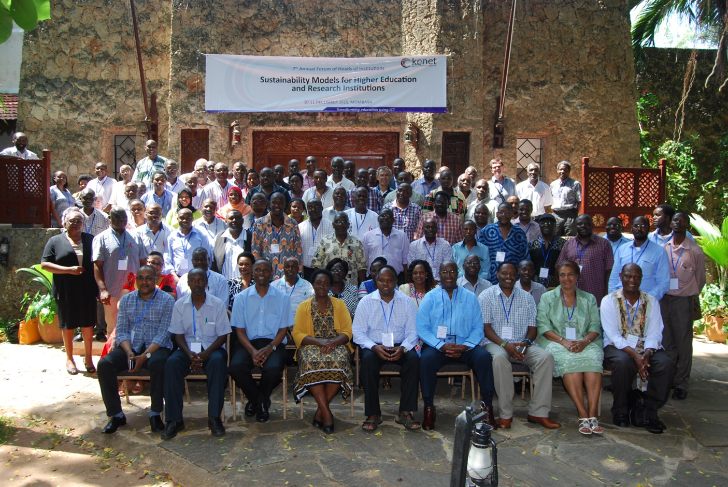
KENET Seeks Permission of Vice Chancellors to Collect Data
Transforming education using ICT

Slide 10
Analog Data Collection and Data Entry over 14 months
Permission to collect data granted by Vice Chancellors
Directed Detailed Questionnaires
  One Research assistant per campus / university (junior ICT or engineering faculty) collects data from head of department
Phase 1 – November 2014 – April 2015
  Printed questionnaires delivered by courier to department heads
  Data even on enrolment NOT easily available
  Completed questionnaires delivered back to KENET by Courier
Data Entry, Data Cleaning, Analysis and Draft Report (May – August 2015)
  Data entry at KENET by statistician and student assistants
  Engineering forum of heads of engineering departments and deans in October 2015 recommends data validation
Data Validated – November 2015 – January 2016
  Data more complete but still missing data on research output and departmental budgets!
SIG on engineering education and KENET network of engineering department heads essential for data cleaning
Transforming education using ICT

Slide 11
Highlights of Engineering Baseline Survey Results
Transforming education using ICT

Slide 12
How many departments / degree programs?
12 Universities offering engineering degree programs
44 departments and 54 unique degree programs
All departments / degree programs classified as:
  CSE – Civil and Structural Engineering programs (10 departments)
  EEE – Electrical and electronics engineering (13 departments
  MME – Mechanical and mechatronics engineering programs (includes agricultural engineering) = 21 departments
MME has the widest range of degree programs and departments (not sure why? )
Transforming education using ICT

Slide 13
Enrolment in 12 Universities
 | University | Number of departments | Total enrollment AY 2014/2015
1 | Dedan Kimathi University | 4 | 534
2 | Egerton University | 4 | 428
3 | Jomo Kenyatta University of Agriculture and Technology | 6 | 2,844
4 | Kenyatta University | 5 | 1,163
5 | Masinde Muliro University of Science and Technology | 3 | 149
6 | Meru University of Science and Technology | 1 | 90
7 | Moi University | 5 | 1,211
8 | Multimedia University of Kenya | 1 | 65
9 | Technical University of Kenya | 4 | 1,765
10 | Technical University of Mombasa | 4 | 226
11 | University of Eldoret | 3 | 70
12 | University of Nairobi | 4 | 1,798
 | Total | 44 | 10,343
Transforming education using ICT

Slide 14
UG Student Enrolment over 3 years
Department | 2012/2013 | 2013/2014 | 2014/2015 | Number of Depts
Civil and structural engineering (CSE) | 1,553 | 1,719 | 3,089 | 10
Electrical and electronics engineering (EEE) | 1,504 | 2,508 | 3,963 | 13
Mechanical and mechatronic engineering (MME) | 1,082 | 1,098 | 3,291 | 21
Total | 4,139 | 5,325 | 10,343 | 44
Transforming education using ICT

Slide 15
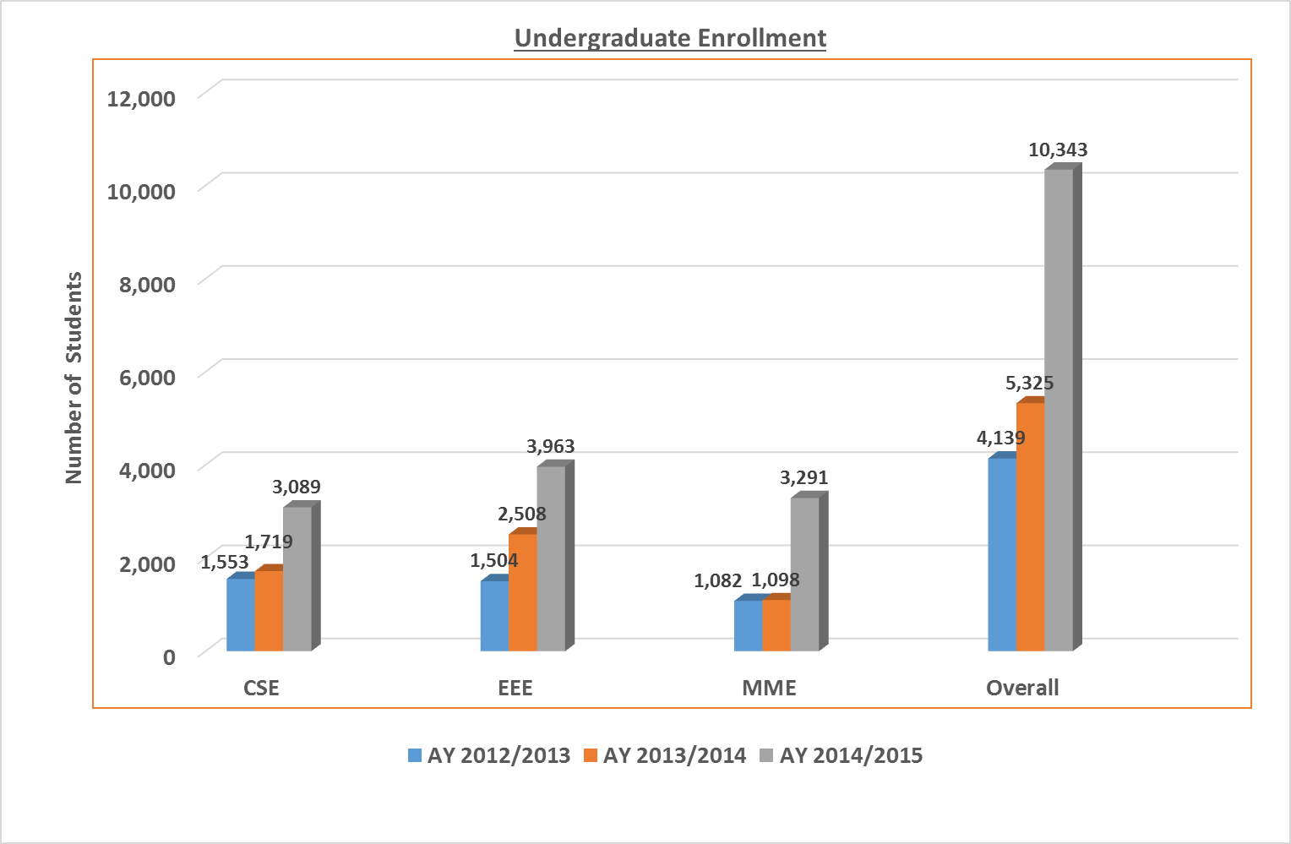
UG Eng. Student Enrolment
(AY 2012/2013 – AY 2014/2015)
Transforming education using ICT

Slide 16
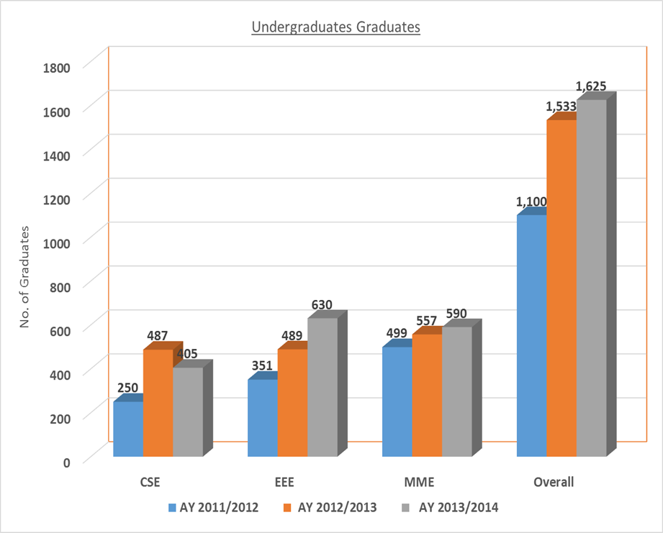
UG Eng. Graduates (3 AYs)
Transforming education using ICT

Slide 17
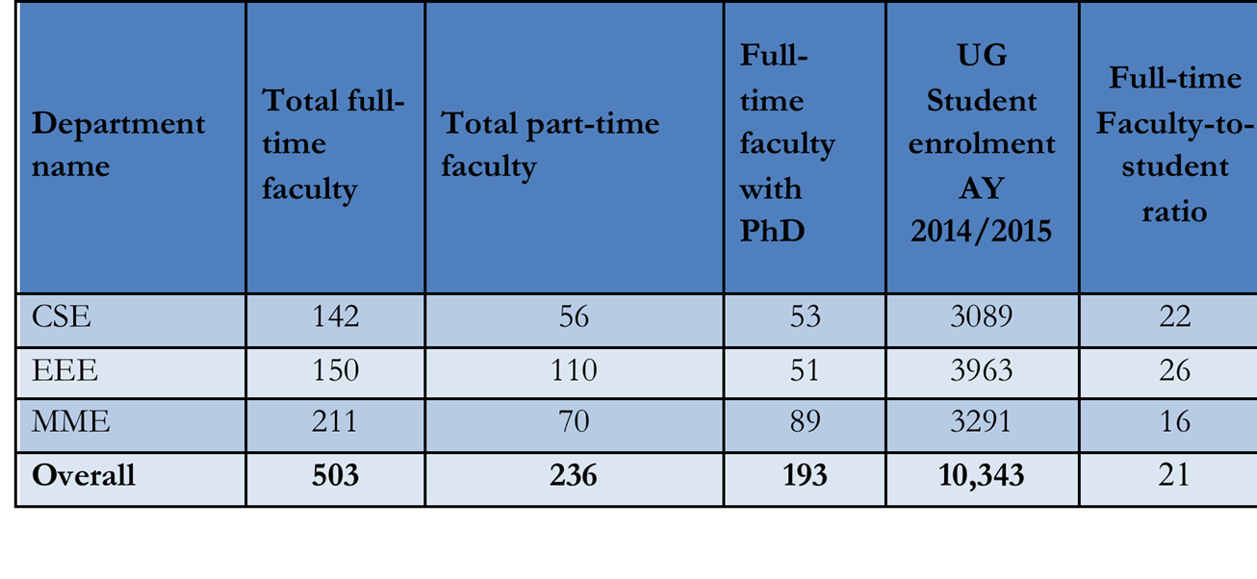
Faculty availability in Kenya
Are they enough?
Transforming education using ICT

Slide 18
Where are the eng. lecturers?
 | University | Full-time faculty (excluding tutorial fellows) | Part-time faculty | Full-time faculty with PhDs
1 | Dedan Kimathi University | 37 | 19 | 8
2 | Egerton University | 42 | 10 | 6
3 | Jomo Kenyatta University of Agriculture and Technology | 118 | 4 | 46
4 | Kenyatta University | 35 | 55 | 15
5 | Masinde Muliro University of Science and Technology | 32 | 16 | 15
6 | Meru University of Science and Technology | 7 | 15 | 2
7 | Moi University | 56 | 8 | 31
8 | Multimedia University of Kenya | 19 | 17 | 2
9 | Technical University of Kenya | 36 | 46 | 13
10 | Technical University of Mombasa | 45 | 28 | 9
11 | University of Eldoret | 13 | 18 | 2
12 | University of Nairobi | 63 | 0 | 44
 | Total | 503 | 236 | 193
63% of lecturers with PhD degrees at UoN, JKUAT and Moi
Transforming education using ICT

Slide 19
Aggregate Faculty and Faculty Ratios
Department name | Total full-time faculty | Total part-time faculty | Full-time faculty with PhD | Undergraduate Student enrollment AY 2014/2015 | Full-time Faculty to student ratio
CSE | 142 | 56 | 53 | 3089 | 22
EEE | 150 | 110 | 51 | 3963 | 26
MME | 211 | 70 | 89 | 3291 | 16
Overall | 503 | 236 | 193 | 10,343 | 21
There no shortage of engineering faculty or faculty with PhDs!
Transforming education using ICT

Slide 20
MSc degree enrolment trends
Transforming education using ICT

Slide 21
Masters Graduates (3 AYs)
Why are most graduate students in MME degree programs?
Transforming education using ICT

Slide 22
PhD Enrollment (3 AYs)
Why are most are in MME degree programs
Transforming education using ICT

Slide 23
PhD graduates (3 AYs)
Transforming education using ICT

Slide 24
Graduates at Post-graduate levels & faculty publications
195 Masters graduates over 3 years (AY 2011/2012 to AY 2013/2014)
36 PhD graduates in engineering over 3 years
  50% in Agricultural engineering
  Egerton, JKUAT and UoN
0.4, 0.6, 0.7 papers per faculty per year in EEE, CSE and MME areas!
Transforming education using ICT

Slide 25
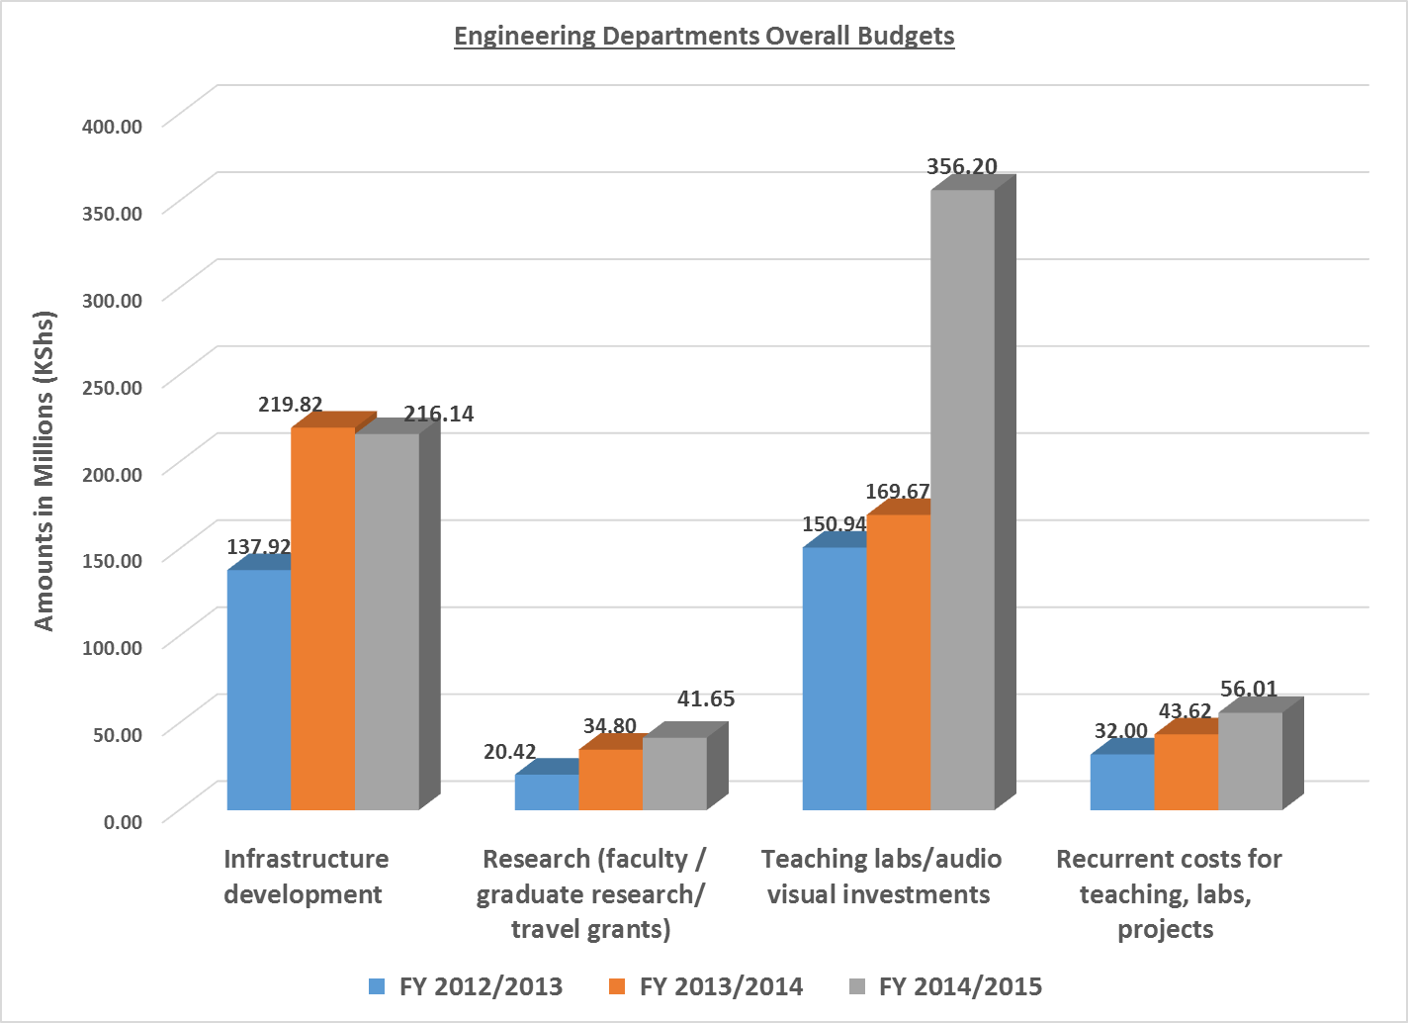
Institutional budget allocations
Transforming education using ICT

Slide 26
Faculty Remuneration – Are universities attracting young faculty?
Faculty rank | Average gross salary (including all monthly allowances) (KSh) | Maximum gross salary (including all monthly allowances) (KSh) | Comparable network engineers ranks | 50th percentile PWC salary (Ksh)
a)Tutorial fellow | 89,259 | 152,411 | Assistant network engineer | 120,076
b)Assistant lecturer | 94,032 | 152,411 | Network engineer | 254,713
c)Lecturer | 114,566 | 210,000 | Senior engineer | 354,095
d)Senior lecturer | 131,358 | 288,200 | Senior engineer | 354,095
e)Associate professor | 161,336 | 310,000 | Chief technical officer | 646,105
F)Full professor | 186,115 | 360,200 | Chief technical officer | 646,105
Is payment non-practicing allowance a solution?
Transforming education using ICT

Slide 27
How about the external view? - Elsevier’s Scival
Six Universities visible as offering engineering degree programs
36 PhD graduates in engineering over same period
  50% in Agricultural engineering
  Egerton, JKUAT and UoN
0.4, 0.6, 0.7 papers per faculty per year in EEE, CSE and MME areas!
Transforming education using ICT

Slide 28
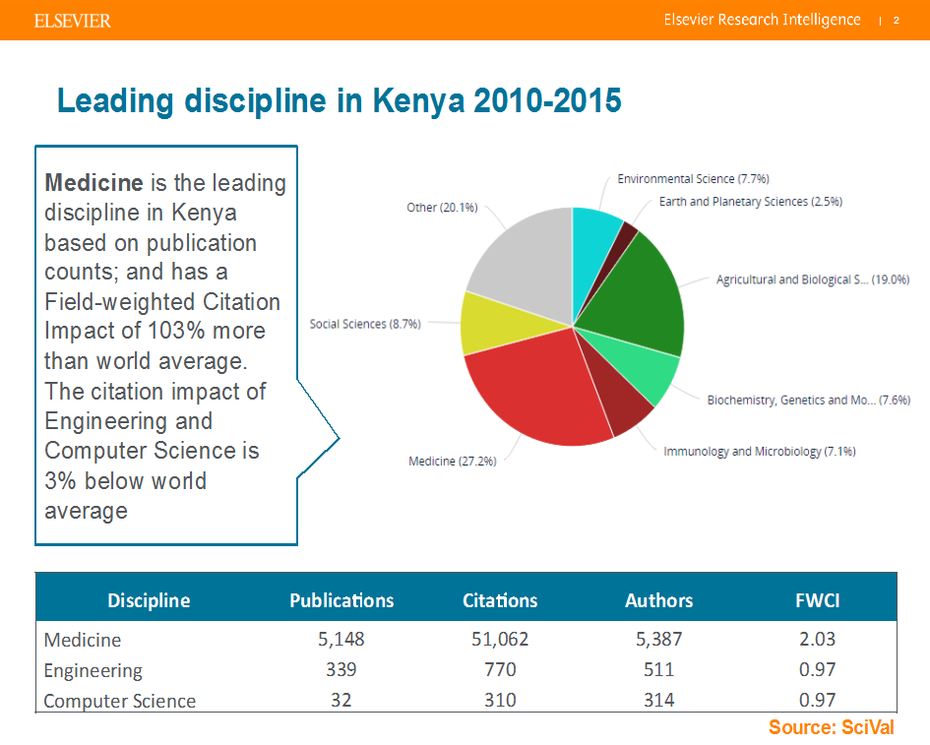
Research output of medicine, engineering & ICT disciplines
Transforming education using ICT

Slide 29
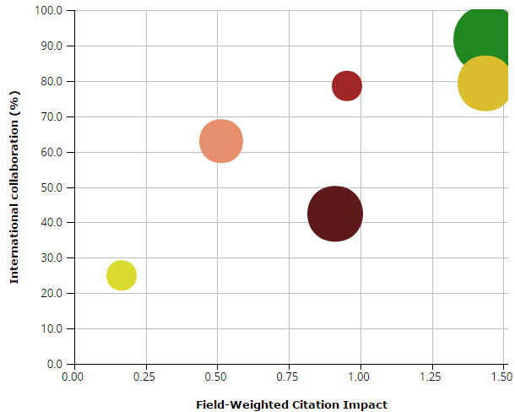
Universities performance in Engineering 2010-2015
Bubble size: Citations per Publication
Egerton
Kenyatta
Egerton has highest international collaboration; highest Field-weighted Citation Impact and most citations per publications
Moi
Nairobi
JKUAT
Maseno
Source: SciVal
Notes:
y-axis:International collaboration (International, %)
Types of publications included: all.
x-axis:Field-Weighted Citation Impact
Types of publications included: all.
Bubble size:Citations per Publication
Types of publications included: all. Self-citations included: yes.

Slide 30
Conclusions
The 503 full-time faculty appear adequate for the 10,343 UG students in AY 2014/2015
  But they are spread over 44 departments, teaching 54 degree programs
  59% of the 10,343 enrolled in EBK accredited engineering program
Engineering faculty publications are low at between 0.4 and 1.1 per faculty per year (confirmation with SciVal or in comparison to Medicine)
  It has to do with research funding / reward system?
  Low enrollment at post-graduate levels and low graduation rates at PhD
No evidence that universities are committing adequate resources to engineering departments – invest in data infrastructures
  Most of heads of departments did not know their budgets!
University ERPs and databases do not appear to be maintaining data on graduates, publications, collaborations
The problem is NOT laboratory or research infrastructures
  Faculty are unaware of FREE advanced e-infrastructures accessible through KENET
Transforming education using ICT

Slide 31
Recommendations
Reduce the number of degree programs and departments to ensure critical mass of faculty in each degree program
Implement an incentive mechanism for Eng. Faculty e.g. Payment of non-practicing allowance OR implement differential pay for critical disciplines to achieve V2030 e.g. Eng – to attract young engineers into universities and retain them
Improve faculty motivation, working environments, remuneration, research grants, travel grants and scholarships for Masters and PhD students by Universities and GoK
  It is NOT about lack of equipment!
Conduct detailed demand-side study for engineering graduates demand and their employment skills
  Involve the Industry (LIWA, KEPSA etc) in the demand-side surveys
Transforming education using ICT

Slide 32
Thank You
www.kenet.or.ke
Jomo Kenyatta Memorial
Library, University of Nairobi
P. O Box 30244-00100, Nairobi.
0732 150 500 / 0703 044 500

